Slide 1
Conducting an Audience Analysis

Slide 2
What is an “Audience Analysis”?
An audience analysis is a process used to identify and understand the priorities and influences for a group of people for which a document is to be produced. The target audience is those people whose behavior must change as a result of reading the document.

Slide 3
Key Components of an Audience Analysis
A complete audience analysis considers :
Socio-demographic characteristics such as sex, age, language and religion.
Geographic characteristics like where the audience lives and how that might impact behavior.
Psychographic characteristics such as needs, hopes, concerns and aspirations.
Background knowledge of the audience members and their current actions related to a particular issue.
Barriers and facilitators that prevent or encourage audience members to adopt the desired behavior change.
Gender and how it impacts audience members’ behavior and ability to change.
Effective communication channels for reaching the audience.

Slide 4
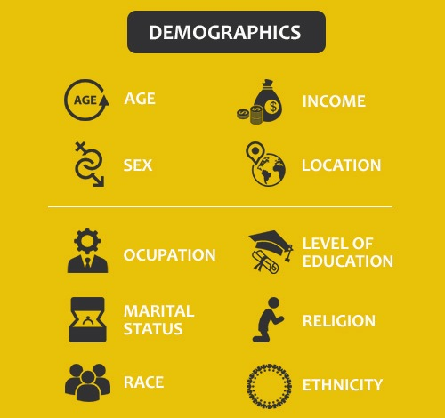
Demographics
Here are the main characteristics you should look to define.

Slide 5
Psychographics
Defining psychographics can be really challenging because it revolves around subjective information in contrast to demographics that rely on quantitative statistical data.
There are 3 main areas you want to define:
What are the interests of your target audience?
What kind of activities (often hobbies) do they take part in?
What are their attitudes/opinions towards particular subjects?

Slide 6
Classifying Target Audience (DMU)
Decision Making Unit (DMU) is a term that describes a group of individuals that are involved in the deciding the course of action for within a specific audience. There are 6 roles in the DMU you need to be aware of (it is important to note that one person can cover multiple roles):

Slide 7
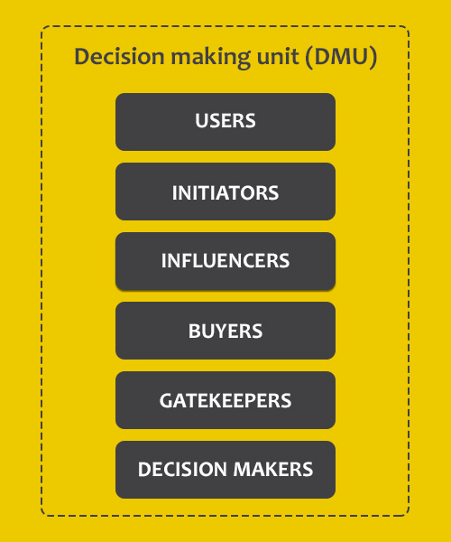
Decision Making Units

Slide 8
DMU Roles Defined
Users are the people that are using your product or service. They have problems and you are here to help them.
An Influencer can be anyone whose opinion has an influence on the decision maker.
Decision makers are the ones that have the final say about the product/service purchases or the implementation of a policy or rule.

Slide 9
Different Roles Require a Different Approach
The main reason you want to distinguish between the DMU roles described is because you want to target them with a different type of content or message.
Users – Awareness, Interest
Influencers – Interest, Consideration, Intent
Decision makers – Intent, Evaluation, Purchase, Implementation

